Slide 1
Operation Remote Resupply PART 3
Visual Studio Mobile Center

Slide 2
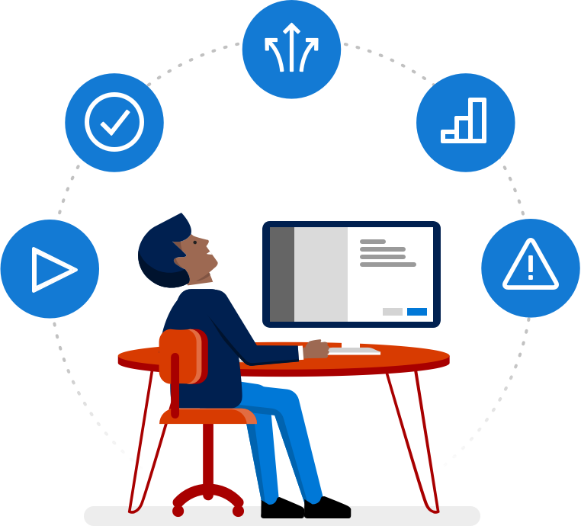
Visual Studio Mobile Center
Automatically build your app, test it on real devices, and distribute it to beta testers
Collect crash reports and user analytics, including custom events
Add cloud-based user authentication and table storage in minutes
Notes:
Visual Studio Mobile Center harmonizes a wide range of services, commonly used by mobile developers, into a single, integrated product. You can build, test, distribute, and monitor your mobile apps and easily add backend cloud services to scale your app to millions of users on demand.

Slide 3
Mobile Center Services
LIFECYCLE SERVICES Build, Test, Distribute
Automatically build your app, test it on real devices, and distribute it to beta testers
MONITORING SERVICES Crashes and Analytics
Collect crash reports and user analytics, including custom events.
MOBILE BACKEND SERVICES Identity, Tables, Push Notifications
Add cloud-based user authentication and table storage in minutes
Notes:
Mobile Center services fall into the general categories of:
Lifecycle services
Monitoring services
Mobile backend services
Lifecycle Test services will be covered in depth in Lab #6 covering the UI tests and the testing framework. Mobile Backend Services are referenced for completeness, but not covered in this lab.

Slide 4
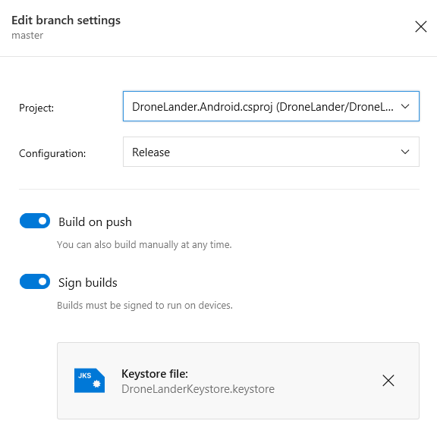
Managing Build Services
Connect to a Git repository
Configure a Build definition
Sign builds
Run launch tests
Automatically distribute
Optionally integrate with testing
Commit code update
Notes:
With Build, you can manage your source code in a Git repository and create an installable app package automatically with every commit or push.
Developers never need to provision any special “agents” or external machines, even when compiling iOS apps. Mobile Center compiles your Android and iOS apps directly from the source code with no manual setup on your side.
Mobile Center supports integration with the following repositories:
GitHub
Bitbucket
Visual Studio Team Services (VSTS)

Slide 5
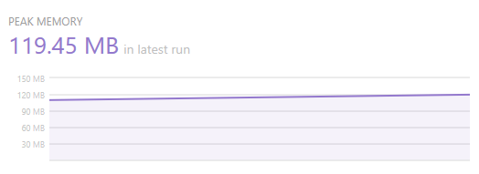
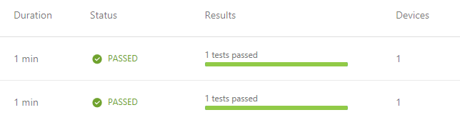
Managing Test Services
Install the Mobile Center command-line interface (CLI)
Add a test project to your solution
Start test runs
View test results
Notes:
With Test, once the build process is finished, you can run your tests on real devices, and more than just the ones you own. With literally thousands of devices and configuration combinations, it would be virtually impossible to do comprehensive testing without a lot of help.
Visual Studio leverages the power of Test Cloud, which supports testing against more than 2000 real devices in 400 unique device configurations, making it easy to validate your mobile app's behavior.
Tests can be written for your Android and iOS in C# (UITest), Ruby (Calabash), or Java (Appium), all backed by Test Cloud.
Test services will be covered in detail in Lab #6: Xamarin UI Tests

Slide 6
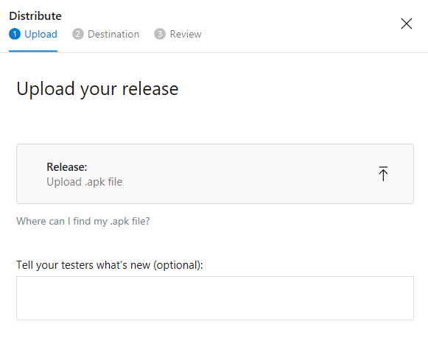

Managing Distribute Services
Create distribution groups
Add users to groups
Commit or upload new builds
Install new releases
Create in-app notifications
Notes:
When developing and testing an app, its critical to have testers involved other than just you. In fact, its best to have at least a handful of testers, the exact scenario the Distribute services offers.
You can simple enter a set of e-mails, organize them into distribution groups, and your users can install the app directly on their phones, just as if they download the app from the app store.
Mobile Center Build, Test and Distribute work together seamlessly, so each of your code commits gets the maximum level of validation. More importantly: None of these features require any modification of your code.

Slide 7
Integrating Crash Services
Add Mobile Center Crash SDK support
Get a platform-specific App “Secret” Identifier
Add code to start SDK processes
Monitor crash activity
using Microsoft.Azure.Mobile;
using Microsoft.Azure.Mobile.Crashes;
MobileCenter.Start("android={Your Android App secret here};" +
"ios={Your iOS App secret here}", typeof(Crashes));
Notes:
You don't want your app to crash, but it happens. And when it does, since its often difficult to diagnose the root cause, you need to have fast and precise information about what went wrong and why.
Once you integrate the Crashes module of the Mobile Center SDK, you can collect crash information from all devices, prioritize them based on the number of users seeing the crash, and even get the full stack traces to help you fix them.
Integration of Crash services is easy:
Add Mobile Center Crash SDK support
Get a platform-specific App “Secret” Identifier
Add code to start SDK processes
Monitor crash activity

Slide 8

Integrating Analytics Services
Add Mobile Center Analytics SDK support
Get a platform-specific App Identifier
Add code to start SDK processes
Monitor event and analytics activity
using Microsoft.Azure.Mobile;
using Microsoft.Azure.Mobile.Analytics;
MobileCenter.Start("android={Your Android App secret here};" +
"ios={Your iOS App secret here}", typeof(Analytics));
Notes:
Wouldn’t it be great to know how many users are launching your app? Where users are located geographically? Which language they speak? How they are using (or not using) your app?
Once you integrate the Analytics module of the Mobile Center SDK, you can get information about the number of daily, weekly, and monthly users, session duration, top devices and OS versions, your app's world map, and even a list of most used languages.
Once you also add our event tracking, you can collect rich behavioral analytics data to understand which feature is used most often, which screens are never seen, or how your app users find in-app purchases.
Just like Crashes, integration of Analytics services is easy, and then steps are basically the same, except that you refer to the Analytics class instead of the Crashes class.

Slide 9
Lab Walkthrough
Visual Studio Mobile Center

